Slide 1
Polymer Science Assignment
Name: Altamash Asif Ghori
Seat # EP-1742004
“Processing of product in any industry and
Polymer processing in industry.”

Slide 2
CEMENT MANUFACTURING PROCESS
PHASES IN INDUSTRIES
Production of cement completes after passing of raw materials from the following six phases. These are;
Raw material extraction/ Quarry
Grinding, Proportioning and Blending
Pre-heater Phase
Kiln Phase
Cooling and Final Grinding
Packing & Shipping

Slide 3
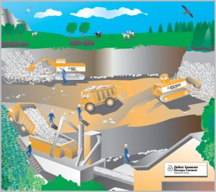
1.RAW MATERIAL EXTRACTION
Cement uses raw materials that cover calcium, silicon, iron and aluminum. Such raw materials are limestone, clay and sand. Limestone is for calcium. It is combined with much smaller proportions of sand and clay. Sand & clay fulfill the need of silicon, iron and aluminum

Slide 4
2.PROPORTIONING,
BLENDING & GRINDING
The raw materials from quarry are now routed in plant laboratory where, they are analyzed and proper proportioning of limestone and clay are making possible before the beginning of grinding. Generally, limestone is 80% and remaining 20% is the clay.

Slide 5
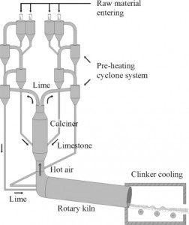
3.PRE-HEATING RAW MATERIAL
After final grinding, the material is ready to face the pre-heating chamber. Pre-heater chamber consists of series of vertical cyclone from where the raw material passes before facing the kiln. Pre-heating chamber utilizes the emitting hot gases from kiln. Pre-heating of the material saves the energy and make plant environmental friendly.

Slide 6
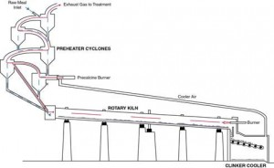
4.KILN PHASE
Kiln is a huge rotating furnace also called as the heart of cement making process. Here, raw material is heated up to 1450 ⁰C. This temperature begins a chemical reaction so called de carbonation. In this reaction material (like limestone) releases the carbon dioxide. High temperature of kiln makes slurry of the material

Slide 7
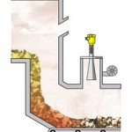
5.COOLING AND FINAL GRINDING
After passing out from the kiln, clinkers are cooled by mean of forced air. Clinker released the absorb heat and cool down to lower temperature. Released heat by clinker is reused by recirculating it back to the kiln. This too saves energy

Slide 8
6.PACKING AND SHIPPING
Material is directly conveyed to the silos (silos are the large storage tanks of cement) from the grinding mills. Further, it is packed to about 20-40 kg bags. Only a small percent of cement is packed in the bags only for those customers whom need is very small. The remaining cement is shipped in bulk quantities by mean of trucks, rails or ships.

Slide 9
POLYMER MANUFACTURING PROCESS
PHASES IN INDUSTRIES
Overview of the various stages:
Mixing
Addition of additives to alter physical, mechanical or aesthetic
properties of the finished product.
Melting
Liquefy polymer and destroy memory of previous chain
configurations.
Melt flow
Flow and shaping of the liquid by mechanical processes
Cross-linking
Formation of chemical cross-links to induce dimensional stability
Cooling and solidification
Transfer of heat away from polymer, crystallization or glass
formation.

Slide 10
1.Mixing
Can add reinforcing fillers (e.g. carbon black, silica) to
toughen the polymer, or non-reinforcing fillers (e.g.
calcium carbonate, china clay) to cheapen the mix.
Plasticisers are used in cases where it is desirable to
increase flexibility, for example PVC is often plasticised
with a high boiling point ester.
Chemical cross-linking agents need to be added to
thermoset polymers, for example in the vulcanisation of
rubbers using sulphur.
Can add chemical blowing agents (e.g. sodium
bicarbonate) to create polymer foams.
Use of pigments or dyes to colour the product.

Slide 11
2.Melting
Need to be aware of heat transfer issues, as degradation
temperature of most polymers is not far above Tm.
Not only is there heat supplied to the polymer by an
external source, but there is also frictional heating due to
the heat dissipated by shearing a highly viscous fluid.
Often, the viscous heat is a considerable proportion of
the total heat required to work the polymer. So much so,
in fact, that it is often possible to make the process self sufficient after the first few batches have been melted via
external heating.
Crystalline polymers (HDPE, PP) require far higher inputs
of energy to melt than amorphous ones (uPVC, PS).

Slide 12
3.Melt flow
Many polymer processing methods involve a polymer
being driven through channels of various dimensions
(extrusion dies, injection moulding gates and moulds).
The resulting orientation induced in the polymer depends
on the Deborah number for that process, and can give
rise to several non-ideal effects such as:
– Melt fracture
On die entry, extensional flow gives rise to tensile stress which
exceed that of the melt, causing flow instabilities.
– Die swell and surface texturing
On die exit, molecules close to the walls of the channel become
shear-oriented and the extrudate swells anisotropically on
cooling. At high shear rates, causes surface texturing effects
such as ‘sharkskin’, ‘orange peel’ and ‘bambooing’.

Slide 13
4.Cross linking
Crosslinking can be accomplished chemically or by irradiation. Chemical crosslinking with rubber material is called Vulcanization. It is accomplished by a heat induced reaction between the polymers and a crosslinking agent. For wire and cable insulations, chemical crosslinking is performed by passing the wire through a long pressurized steam tube, called a continuous vulcanizing (C.V.) machine. Other methods of crosslinking include: Moisture cure, salt cure, and hot air vulcanization (HAV).
Not all materials can be cross linked, but for those that are able, the results are important

Slide 14
5.cooling, solidification
Often the most limiting factor in the process is the transfer
of heat away from the polymer.
This is particularly a problem for thermoplastics, where
dimensional stability is not achieved until the temperature
falls well below Tm.
Due to the relatively low thermal conductivity of polymers,
the designer must keep the wall thicknesses as small as
possible to reduce the total cooling time to reasonable
values.
Even so, typical cooling times for thermoplastic processes
are between 10-100 seconds (the largest proportion of the
process time)
←-----------------------------→

